Slide 1
Linear Algebra
Lecture 32

Slide 2
Linear Algebra
Lecture 32

Slide 3
Eigenvalues and
Eigenvectors

Slide 4
Complex
Eigen-values

Slide 5

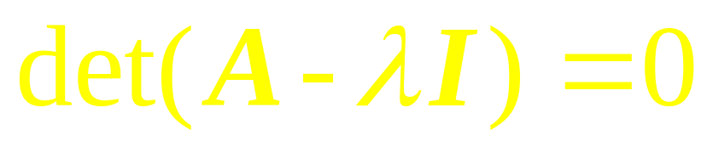

Definition
A complex scalar satisfies
if and only if there is a nonzero vector x in C^{n} such that We call a (complex) eigenvalue and x a (complex) eigenvector corresponding to .

Slide 6
Example 1

Slide 7
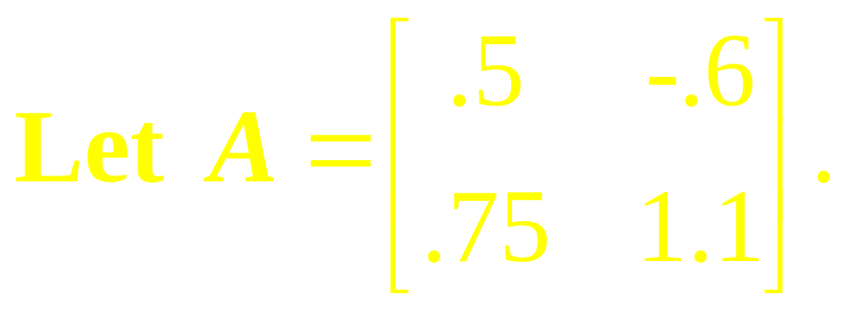
Example 2
Find the Eigen-values of A, and find a basis for each Eigen-space.

Slide 8
Example 3

Slide 9
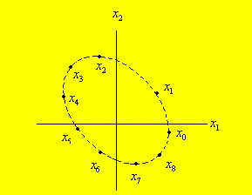
Example 3

Slide 10
Real and Imaginary
Parts of Vectors
…

Slide 11
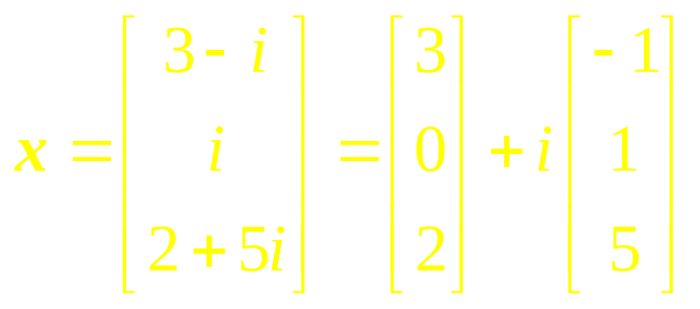
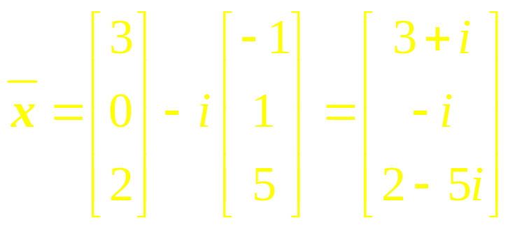
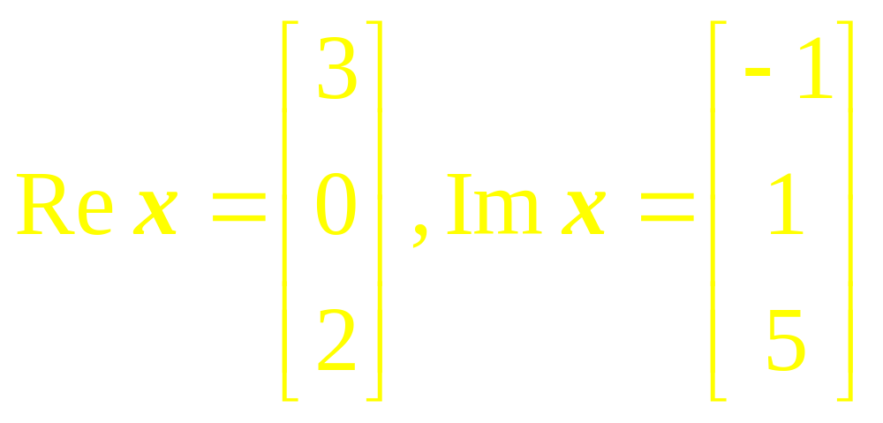
Example 4

Slide 12
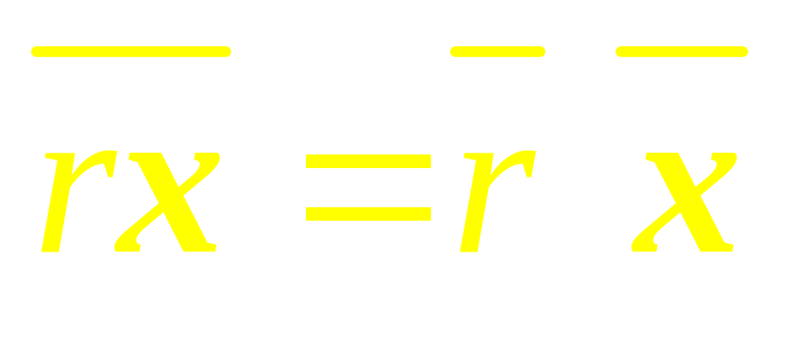
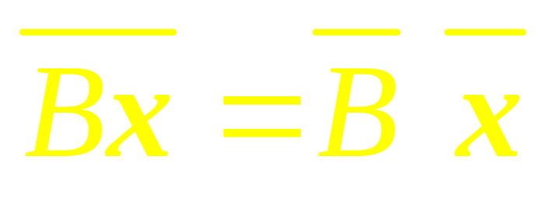
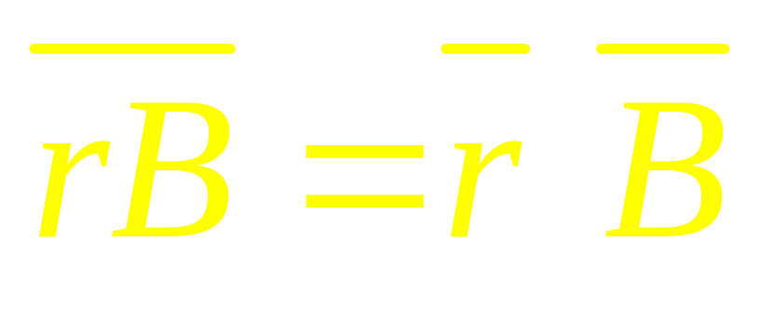
Note that

Slide 13
Eigenvalues and
Eigenvectors
of a Real Matrix
that acts on
C^{n}

Slide 14
Example 5

Slide 15
Example 6

Slide 16
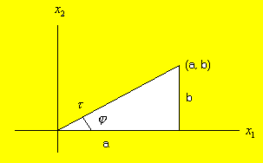

Slide 17
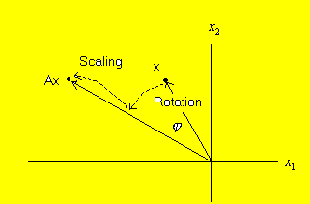

Slide 18
Example 7

Slide 19
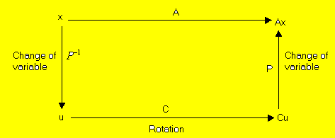

Slide 20
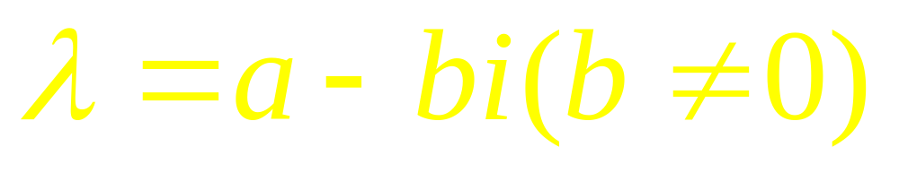
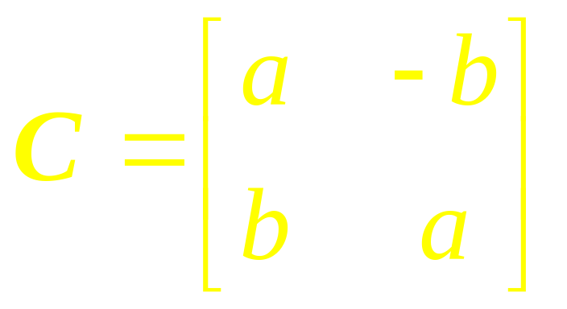
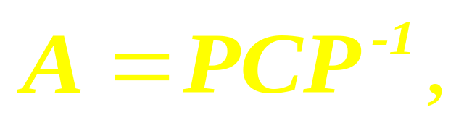
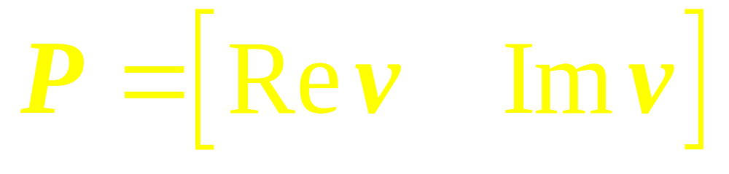
Theorem
Let A be a real 2x2 matrix with complex Eigen-values
And associated Eigen-vectors v in C². Then

Slide 21
Linear Algebra
Lecture 32

